Slide 1
Localization
Advanced Android Development
Lesson 5

Slide 2

5.1 Languages and layouts
Modify an app for a user's language

Slide 3
Contents
Overview of user language and locale choices
Preparing an app for localization
Using the Translations Editor tab in Android Studio
Adjusting layouts for right-to-left (RTL) languages
Testing apps with language and locale choices

Slide 4
Overview
User language and locale choices

Slide 5
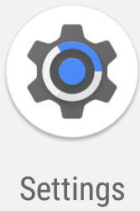
Language and locale settings
Users choose language and locale in Settings
Examples: same language in different locales
English (U.S.), English (U.K.)
Français (France), Français (Canada)
Nougat (API 24) and newer: users can choose multiple languages in order of preference

Slide 6
Modify apps for languages
To reach more users, localize your app for each locale
Add language/locale resources for translated text
Adjust the layout to support different languages
Default language appears for unsupported locales

Slide 7
Preparing an app for localization

Slide 8
Prepare for a different language
Identify all elements to translate
Extract all strings as resources into strings.xml
Use the Translations Editor tab to add languages and translations
Change layouts for right-to-left (RTL) languages

Slide 9
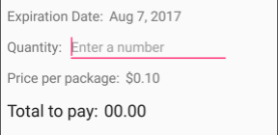
Identify elements to translate
All UI text
Content, menus, navigation tabs, messages
Headings, labels for entry fields
Elements that need locale formatting
Dates, times, numbers
Currencies

Slide 10
Best practices for localizing text
Add languages using the Translations Editor tab
Provide translations for all strings
Don't concatenate pieces to make sentences or phrases
For strings with variable content use format strings with String.format()

Slide 11
Layout and media tips
Watch for images and colors that offend certain cultures
Avoid humor, which rarely translates well
Don't use images that contain text
Include comments to the translator in strings.xml
<!-- All comments are notes to translators. -->
<!-- Help option in the options menu, no more than 30 chars. -->
<string name="action_help">Help</string>
...

Slide 12
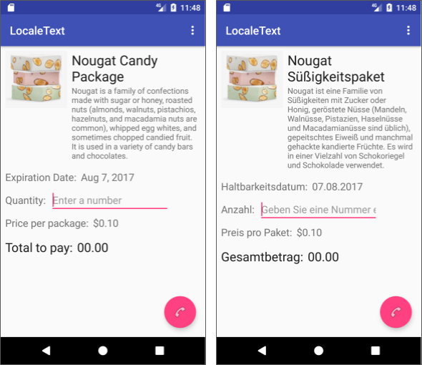
Identify layout issues (1)
Text grows or shrinks depending on language
Leave 30% extra space for growth

Slide 13
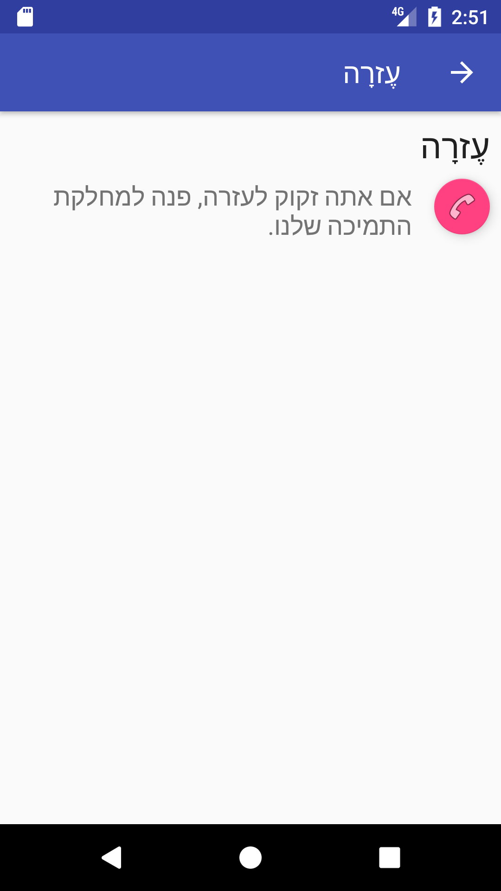
Identify layout issues (2)
Adjust navigation elements for RTL layouts
Up button on opposite side
Floating action button (FAB) on opposite side

Slide 14
Using the Translations Editor
Adding languages and translations

Slide 15
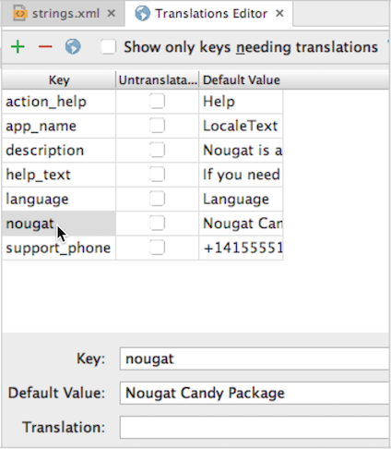
Android Studio Translations Editor
Click Open editor at top of strings.xml in layout editor
Shows string resource keys and default values
Provides field for adding translations

Slide 16
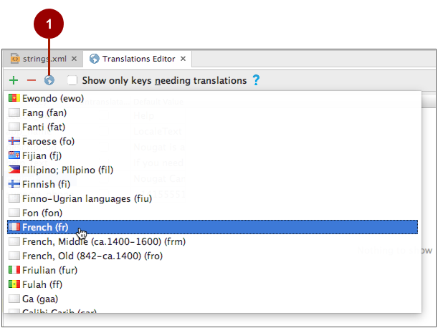
Add a language
Click globe button to add a language

Slide 17
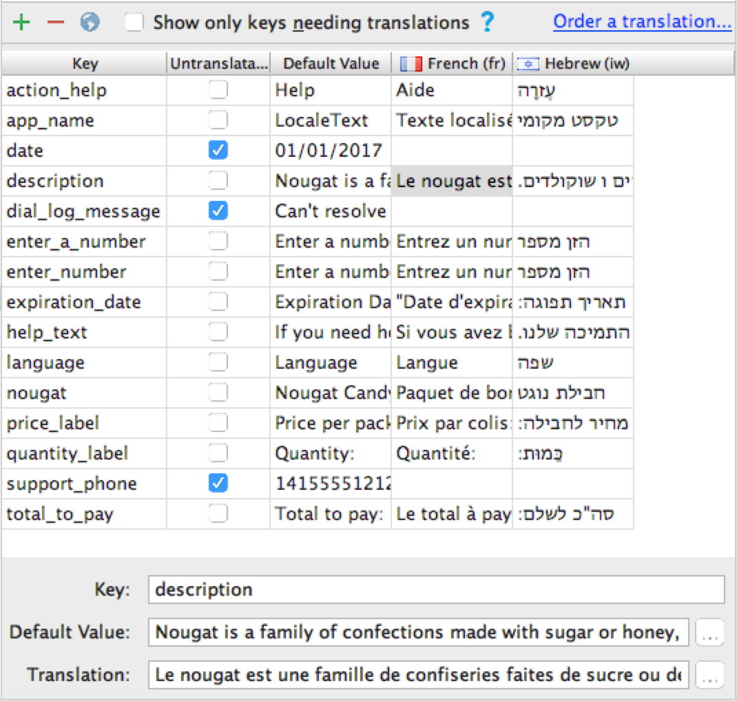
Enter translation
Select cell in the language column
Select the Untranslatable checkbox for any key that should not be translated
For any key that should be translated, enter the translation in the Translation field

Slide 18
Adjusting the layouts for RTL languages

Slide 19
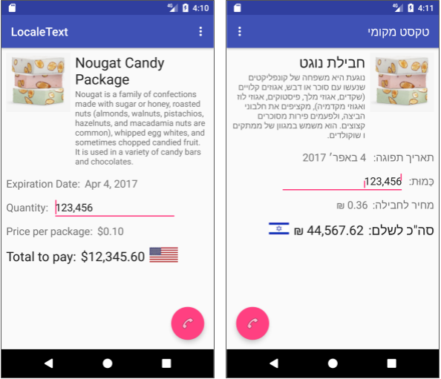
Layout mirroring
Layout mirroring (API 17+) redraws layout for RTL languages
Enable mirroring in the AndroidManifest.xml file:
android:supportsRtl="true"

Slide 20
Layout mirroring compatibility
minSdkVersion < 17: Add "start" and "end" attributes in addition to "left and "right"
android:layout_marginLeft
android:layout_marginStart
android:layout_marginRight android:layout_marginEnd
minSdkVersion => 17: Replace attributes for "left" and "right" with "start" and "end"

Slide 21
Adjust left/right positioning
Add to or replace "left" and "right" for
Constraint attributes
app:layout_constraintLeft_toRightOf="@+id/product_image" app:layout_constraintStart_toEndOf="@+id/product_image"
RelativeLayout attributes
android:layout_alignParentLeft android:layout_alignParentStart
Margins and padding

Slide 22
Testing languages and layouts

Slide 23
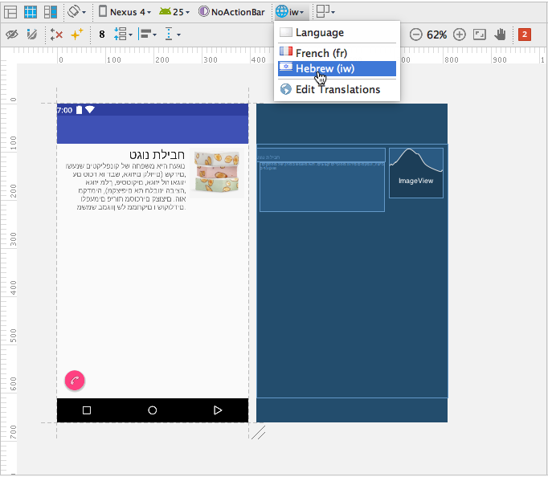
Layout mirroring preview
Preview layout mirroring for RTL in layout editor:
Click Design tab
Select language from the Language menu

Slide 24

Use Settings (Marshmallow and older)
Device or emulator:
Select Languages & input > Language
The Languages choice is first in the list
Select a language and locale

Slide 25
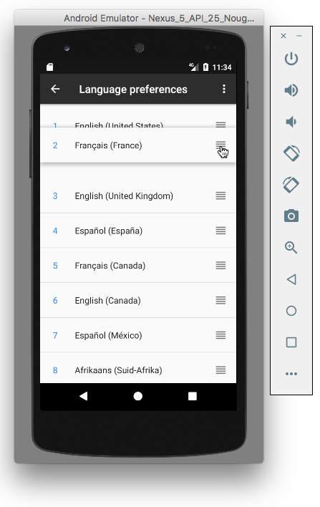
Use Settings (Nougat and newer)
Device or emulator:
Select Languages & input > Languages
The Languages choice is first in the list
Select Add a language and select the language and locale
Drag the "move" icon to move language to preference order in list

Slide 26
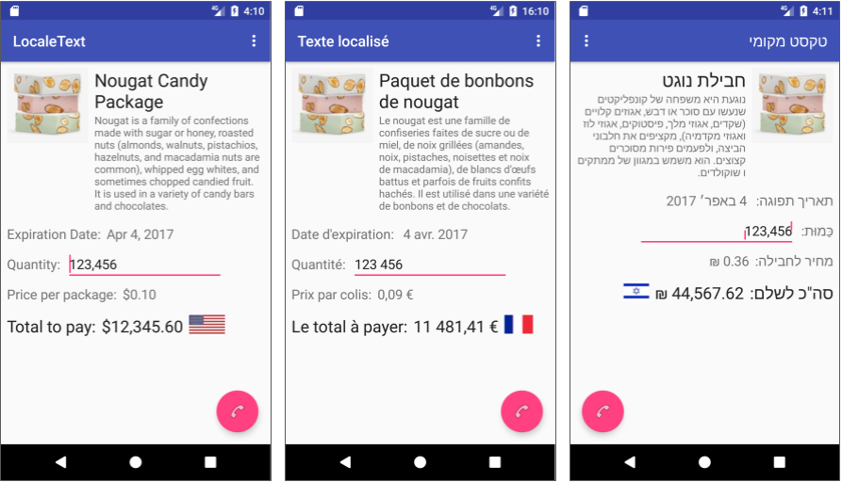
Run the app
Change language in the device or emulator
Run the app

Slide 27
What's next?
Concept chapter: 5.1 Languages and layouts
Practical: 5.1 Using resources for languages

Slide 28
END

